Slide 2
Govt. Poly. Dhangar, Fatehabad
Branch:-Electrical Engg.
Sem.:-3rd
Sub:-FUNDAMENTALS OF ELECTRICAL ENGINEERING
Prepared By:-
Er. Pardeep Nain
Faculty in Electrical Engg. Dept.

Slide 3
CONTENTS
Introduction
Different forms of energy
Advantages of electrical energy
Uses of electrical energy
Basic concept of charge, current, voltage, resistance, power, energy and their units
Conversion of units of work, power and energy from one form to another
Ohm’s law, resistances in series and parallel
Kirchhoff’s laws and their applications in solving electrical network problems
Network theorems such as Thevenin’s theorem, superposition theorem Maximum power transfer theorem and Norton’s theorem

Slide 4
Electrical Energy
Electrical energy is a form of energy resulting from the flow of electric charge. Energy is the ability to do work or apply force to move an object.
Energy comes in two basic forms:
potential and kinetic
Potential Energy is any type of stored energy. It can be chemical, nuclear, gravitational, or mechanical.
Kinetic Energy is found in movement

Slide 5
Advantages of Electrical Energy
Convenient form. Electrical energy is a very useful form of energy. It can be easily transformed into other forms of energy. For example, if we want to convert electrical energy into heat, we just need to pass electrical current through a wire of high resistance, for example, a heater. Similarly, electrical energy can be converted into light (e.g., an electric bulb), mechanical energy (e.g., electric motors), etc.
Easy control. The electrically operated machines have simple and easy starting, control, and operation. For instance, an electric motor can be operated by turning on or off a switch. Similarly, with simple arrangements, the speed of electric motors can be easily varied over the desired range.
Greater flexibility. One important reason for preferring electrical energy is the flexibility that it offers. It can be easily transported from one place to another with the help of conductors.
Cheapness. Electrical energy is much cheaper than other forms of energy. Thus, it is overall economical to use this form of energy for domestic, commercial, and industrial purposes.
Cleanliness. Electrical energy is not associated with smoke, fumes, or poisonous gases. Therefore, its use ensures cleanliness and healthy conditions.
High-transmission efficiency. The consumers of electrical energy are generally situated quite away from the centers of its production. The electrical energy can be transmitted conveniently and efficiently from the centers of generation to the consumers with the help of overhead conductors known as transmission lines.

Slide 6
Uses of electrical energy
Residential
Commercial
Industrial
Transportation
Agricultural
Communication

Slide 7
Basic concept of charge(Q)
Electric charge is a property of matter. While many sub-atomic particles carry charge, for the purposes of this class, the important charged particles are protons and electrons. There are two kinds of charge, which we call positive and negative charge. These names are historical, and we could just as well call them black and white charge, or male and female charge.
The point is that there are two kinds of charge. Charges that are of the same type (negative and negative or positive and positive) repel each other. Charges that are different (negative and positive) attract each other.
The S.I. unit for charge is the Coulomb, where 1 Coulomb is the charge on 6.25 x 1018 electrons or protons. This means that the charge on 1 electron or 1 proton is 1.6 x 10-19 Coulombs (where the protons have positive charge and the electrons have negative charge). Coulomb’s Law tells us how strong the attractive or repulsive force is

Slide 8
Electric Current (I)
Most of the interesting and useful applications of electricity are due to the movement or flow of charge. The flow of electric charge is called electric current, and electric current is measured by the rate of flow of charge.
So we have I = ΔQ /Δt where the letter I represent the current.
Because the rate of flow often fluctuates very rapidly, we sometimes distinguish between average and instantaneous current.
The S.I. unit for current is the Ampere (Amp), where 1 Ampere = 1 Coulomb per second (1A = 1C/s). Electric current can refer to positive or negative charges flowing but, in most cases, we are talking about electrons moving in a conductor.

Slide 9
Resistance(R)
Different materials present varying opposition to the flow of current. Some materials, called conductors (copper, silver) conduct electricity easier while some materials, called insulators (plastic, rubber), present much more opposition to the flow of current.
A property of the material, called the resistivity (ρ), is a measure of how poor of a conductor it is, so a high resistivity material will allow less current to flow than a low resistivity material of the same size and shape.
The resistivity of most materials increases with temperature so, as wires get hotter, they allow less electricity to flow. This makes sense when we remember that the temperature of a solid is a measure of the microscopic thermal kinetic energies of the molecules in the solid.

Slide 10
In addition to the resistivity of the material, the length (L) and thickness (cross-sectional area – A)) of a particular sample (like a certain piece of wire) also affect how much it opposes the flow of current. The combined effect of these three factors is called the resistance (R) of the particular sample and is measured in Ohms (Ω).
Mathematically, we have R = ρL / A
where ρ is is the resistivity of the material (measured in Ωm), L is the length (in meters), and A is the cross-sectional area measured in meter square .

Slide 11
Power (P)
Power is the work done in per unit time.
In an electric circuit, the power delivered by the voltage source (the battery or wall outlet) is simple to calculate.
P = IV
Power (P) is a measure of the rate at which energy is delivered or used by a circuit element. Voltage sources deliver power, while resistors use power (by dissipating it as heat). Power is equal to the voltage across a circuit element multiplied by the current flowing through it, The unit for power is the Watt (W), which is equal to a Joule per second,

Slide 12
Electrical Energy
Electrical energy is the work done by electric charge. If current i ampere flows through a conductor or through any other conductive element of potential difference v volts across it, for time t second, the electric energy is,
Electrical Energy = v*i*t
we find the unit of electrical energy is joule. Commercially, we also use other units of electrical energy, such as watt-hours, kilo watt hours, megawatt hours etc.

Slide 13
Ohm’s Law
Ohm’s law is named after the scientist Ohm who gave this law.
According to the Ohm’s law current flowing through a conductor is directly ∝ to the potential difference applied between the ends of the conductor.
This means if the potential difference applied at the ends increases then the current flowing through the conductor also increases and vice-versa.
Mathematically
Current flowing through the conductor I ∝ V where V is the potential difference applied at the ends of the conductor.
Or I=(constant) V where constant = 1/R where R =resistance of the conductor
I=(1/R)V
V=IR

Slide 14
Resistors In series
Resistors in Series: A series circuit is a circuit in which resistors are arranged in a single chain, resulting in common current flowing through them.
Circuit Diagram
‘N’ number of resistors can be joined together.
As all the resistors are connected to each other as a result same amount of current flows through each resistor.
But the Potential difference will be different in each resistor.
Consider current flowing through all the resistors =I,Resistance across first resistor=R₁.
Potential difference across resistor R₁is V_{1,} V₁=IR₁(By ohm’s Law)
Similarly V₂=IR₂, V₃= IR₃ and so on.
Therefore Total Voltage V=V₁+V₂+V₃+….. +V_{n}
IR_{equivalent} =IR₁+IR₂+IR₃+…. +IR_{n} where R_{equivalent} is the equivalent resistance of the circuit.
=>R_{equivalent} =(R₁+ R₂+ R₃+….+R_{n})
Therefore if the resistances are connected in series then the total equivalent resistance of the circuit is equal to the sum of all the resistors in the circuit.

Slide 15
Resistors in Parallel
A parallel circuit is a circuit in which the resistors are arranged with their heads connected together, and their tails connected together.
The potential difference(V)across each resistoris same.
The amount of current flowing is different. This means I= I₁+I₂+I₃+…+I_{n}
From Ohm’s law –
(V/R_{equivalent}) = (V/R₁)+(V/R₂)+(V/R₃)+…..+(V/R_{n})
1/ R_{equivalent} =(1/ R₁+1/ R₂+1/R₃+….+1/R_{n})
Therefore if the resistances are connected in parallel then the total equivalent resistance of the circuit is equal to the sum of the reciprocal of all the resistors connected in the circuit.

Slide 16
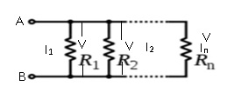
Circuit diagram

Slide 17
Kirchhoff’s laws
Kirchhoff’s First law: Junction law
Junction Law is also known as Kirchhoff’s First Law.
It states that at the junction, sum of current entering the junction is equal to the sum of current leaving the junction.
Junction is any point in the circuit.

Slide 18
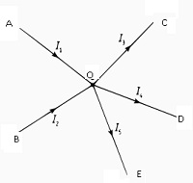
Consider a case where I₁ and I₂are the current entering the junction and,currentI₄ and I₅ are exiting out of the junction.
According to Kirchhoff’s law; I₁+ I₂ =I₃+ I₄+ I₅

Slide 19
Kirchhoff’s Second law: Loop law
Loop law is also known as Kirchhoff’s Second Law.
It states that in a closed loop, algebraic sum of Emfs is equal to the algebraic sum of product of resistances and respective currents flowing through them.
Consider a simple circuit having Emfs = E₁ and E₂; R₁ and R₂ =resistances; current =I₁ and I₂.
Then according to this law : E₁+E₂=I₁R₁+ I₂R₂

Slide 20
For example:-Consider given figure,let Emfs be E₁ and E₂ internal resistances be R₁, R₂ and R₃.
Steps to use Kirchhoff’s law:-
Choose the loop to apply Kirchhoff’s law.
Assume any direction.
Emf is +ive if assumed direction leaving +ive terminal of battery.
IR is +ive if the current in the assumed direction.
Consider closed loop ABCDFA, using the assumptions;
E₂=+R₂I₃ +R₃I₂ ;where I₃=current flowing through R₃
Closed loop FCDEF, +E₁= +I₁R₁ + I₃R₂
Closed loop ABDEA, -E₁ + E₂ = -I₁R₁ +I₂R₃

Slide 21
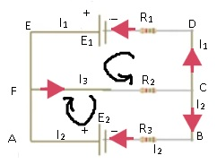
If the direction of current is taken opposite then
Closed loop ABCDFA ;- -E₂=-R₂I₃-R₃I₂
FCDEF; -E₁= -I₁R₁ - I₃R₂
ABDEA; +E₁ - E₂ = +I₁R₁ -I₂R₃

Slide 22
Superposition Theorem
Total current through or voltage across a resistor or branch
Determine by adding effects due to each source acting independently
Replace a voltage source with a short
Replace a current source with an open
Find results of branches using each source independently
Algebraically combine results
Power
Not a linear quantity
Found by squaring voltage or current
Theorem does not apply to power
To find power using superposition
Determine voltage or current
Calculate power

Slide 23
Thévenin’s Theorem
Lumped linear bilateral network
May be reduced to a simplified two-terminal circuit
Consists of a single voltage source and series resistance
Voltage source
Thévenin equivalent voltage, E_{Th}.
Series resistance is Thévenin equivalent resistance, R_{Th}

Slide 24
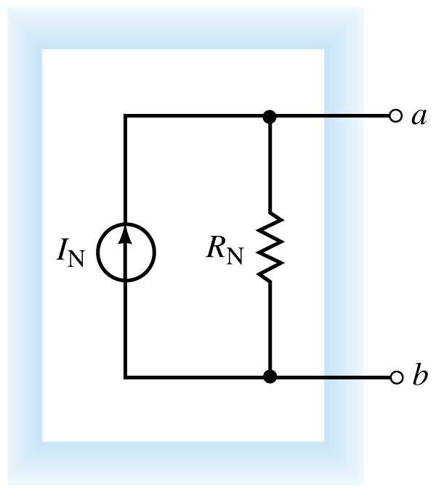
Thévenin’s Theorem Equivalent circuit

Slide 25
To convert to a Thévenin circuit
First identify and remove load from circuit
Label resulting open terminals
Set all sources to zero
Replace voltage sources with shorts, current sources with opens
Determine Thévenin equivalent resistance as seen by open circuit.
Replace sources and calculate voltage across open
If there is more than one source
Superposition theorem could be used
Resulting open-circuit voltage is Thévenin equivalent voltage
Draw Thévenin equivalent circuit, including load

Slide 26
Norton’s Theorem
Similar to Thévenin circuit
Any lumped linear bilateral network
May be reduced to a two-terminal circuit
Single current source and single shunt resistor
R_{N} = R_{Th}
I_{N} is Norton equivalent current

Slide 27
Norton’s Theorem Equivalent circuit

Slide 28
To convert to a Norton circuit
Identify and remove load from circuit
Label resulting two open terminals
Set all sources to zero
Determine open circuit resistance
This is Norton equivalent resistance
Note
This is accomplished in the same manner as Thévenin equivalent resistance
Replace sources and determine current that would flow through a short place between two terminals
This current is the Norton equivalent current
For multiple sources
Superposition theorem could be used
Draw the Norton equivalent circuit
Including the load

Slide 29
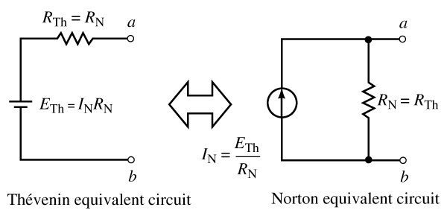
Norton equivalent circuit
May be determined directly from a Thévenin circuit (or vice-versa) by using source transformation theorem

Slide 30
Maximum Power Transfer
Load should receive maximum amount of power from source
Maximum power transfer theorem states
Load will receive maximum power from a circuit when resistance of the load is exactly the same as Thévenin (or Norton) equivalent resistance of the circuit
To calculate maximum power delivered by source to load
Use P = V²/R
Voltage across load is one half of Thévenin equivalent voltage

Slide 31
Power across a load changes as load changes by using a variable resistance as the load

